Slide 1
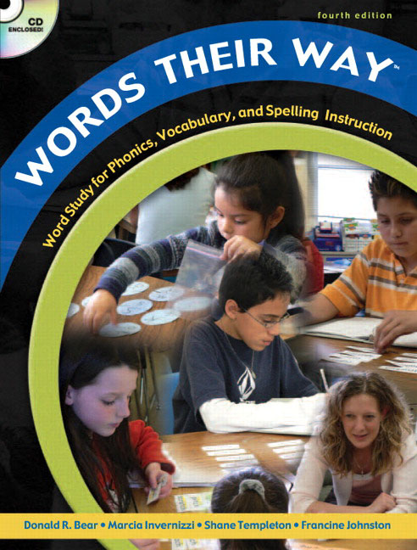
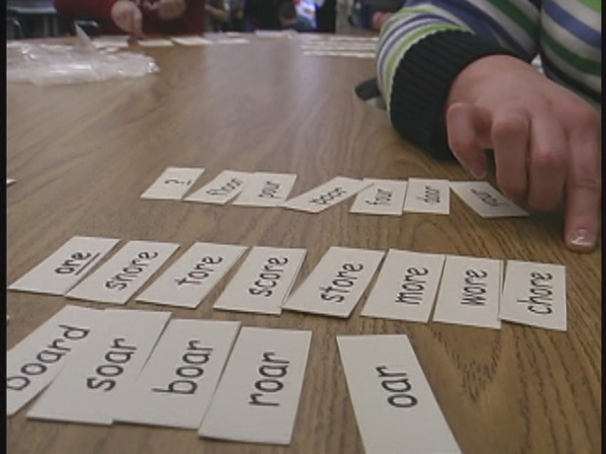
What is it? Why is it important?
Word
Work

Slide 2
What is Word Work?
Integration of phonics, spelling and vocabulary.
Spelling- based on patterns that students are using but confusing, patterns the student is ready to learn and patterns the student has recently learned.
Students sort words that compare and contrast spelling patterns
Studying patterns eliminates “Friday Spellers”.
Sort words by sound and pattern
Students should be able to read words in isolation.
Vocabulary based on frequency, richness of words, facets of words and relationships between words.

Slide 3
Why is it important?
A child’s spelling and word recognition are highly correlated with one another (. 87) as they both depend on the child's current understanding of how letters work in words.
It was determined that most children need direct work in spelling/ phonics. Children who participated in a reading program with phonics work became better readers than children who participated in a reading program without word work (Jeane Challe).
Students develop a general knowledge of English spelling. Students discover generalizations, regularities, patterns and conventions of English orthography needed to read and write.

Slide 4
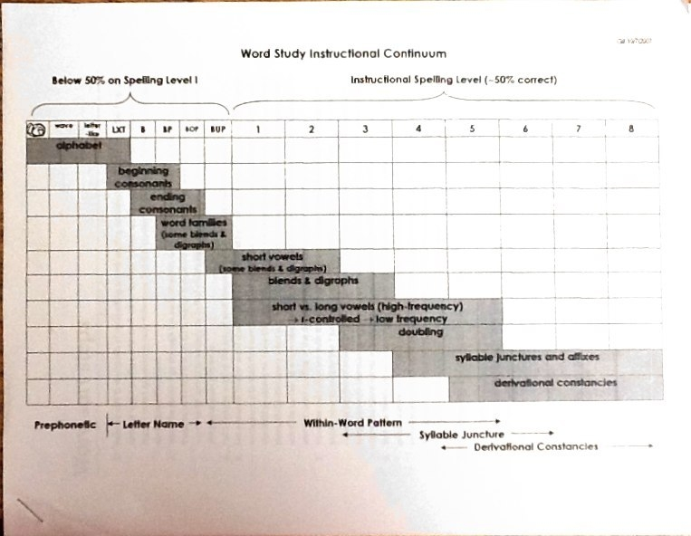
Word Study Levels
Notes:
Prephonetic- students not yet reading conventionally. Children learn to recognize and write letters of the alphabet. Play with sounds in letters and words. Students sort pictures by rhyme and beginning sound. By end can match picture cards to words.
Letter Name- Apply alphabet principles to consonants. By end can correctly represent most short-vowel patterns, consonant digraphs and blends
Within Word- Spell most single-syllable, short-vowel words correctly. Move away from letter name spelling (sound by sound) and begin to include patterns or chunks of letter sequences that relate to sound and meaning.
Syllable Juncture- Focus is multisyllabic words and patterns. Sort by specific vowel combinations, inflected endings, vowel patterns in accented syllables. This level also includes how syllables divide in words and some prefixes and suffixes.
Derivational Constancies- students spell most words correctly. Students learn to sort words by pattern and meaning, with an emphasis on meaning and related word parts. Students learn common prefixes and suffixes and examine the meaning of base and root words. We study Greek and Latin stems to maximize vocabulary accquistion.

Slide 5
What does Word Work look like?
In school:
At home:
Students sorting words according to sound, pattern, or meaning.
Students applying skills taught by correctly spelling words in everyday writing.
Students noticing spelling words in reading and through vocabulary practice.
Assessments.
Students sharing with parents what sort they learned in school.
Students practicing the sort many times to gain automatic recall.
Students practicing the word study activities taught to them in school.

Slide 6
Words Their Way Lingo
Header – spelling patterns for the week– These look like CVC, CVCe, CVVC, CVCle, and so on
V = vowel, C = consonant (VCV word: later) *Encourage students to find the vowel first, then look for the rest of the pattern.
CVCe = consonant-vowel-consonant pattern with an e on the end. (CVCe: space)
Oddball or “Out of Sorts” – words in a word list that do not fall into the regular sorting categories for the week. (If the pattern is long a sound like paint, the word “said” would be an oddball because it has a short e sound, ‘sed’, even though it follows the “ai” spelling pattern.)

Slide 7
Let’s Sort
Hint: Look for the (V) vowel first. Then look for the (C) consonants in the word pattern.
Step 1: Look at words and headers.
Step 2: Arrange headers on top and sort words.
āCVCe
It’s ok that “blame” has 2 consonants before the vowel. It still follows this pattern for the long a sound with CVCe.
āCVCe
ăCVC
āCVVC
oddball
said
blame
camp
paint
said
camp
ă CVC
frame
rash
train
rash
“Said” is the oddball. Although it follows the CVVC pattern, the sound is long not long “A” so it doesn’t belong in the other categories.
blame
Step 3: Read each word aloud. Explain why the word belongs in its category.
frame
paint
oddball
āCVVC
train

Slide 8
Word Study Activities Words Their Way
BLIND SORT
Student listens as a parent calls out the words one at a time and writes the word in the correct category.
TEACH SORT
Teach your parents or a sibling the sort you learned in school. Read each word aloud as you are sorting. Explain why the words are sorted in a particular way. Sort the words a second time as fast as possible.
MEMORY
Just like the game memory, students turn words cards over. Players take turns choosing a pair of words that looks and sounds the same. Players must be able to read the words correctly to get a point.
WORD HUNT
Students should hunt for words in their book that match the sound/pattern/meaning unit they are studying. Students can keep track of the words by recording them in their Word Study Notebook under the correct headers.
WRITING SORT
Student copies words from their pile into the correct categories in Word Study Notebook.

Slide 9
Greek and Latin Stems
ante before antecedent
anti against antithesis
bi two bilateral
circum around circumnavigate
com together common
con together confidence
de down deplete
dis away disperse
equi equal equitable
extra beyond extraordinary

Slide 10
Word Study Activities continued Vocabulary
prime, pivotal, antithesis, ferret, audible
INFORMATION
Definitions, synonyms, antonyms, parts of speech, word origin
FIGURATIVE LANGUAGE
Simile, metaphor, personification, alliteration, hyperbole
OTHER IDEAS
Complex sentences
Illustrations
Quotes
Analogies
Examples from text
QUESTIONING
Convergent, divergent and evaluative thinking questions utilizing vocabulary

Slide 11
Connecting Across the Curriculum
SPELLING
Differentiated spelling word lists for students to best meet individual needs.
Hands-on approach to learning the word sounds, patterns, and meanings.
WRITING
Improved spelling in writing.
High frequency words mastery.
READING
Improved decoding in reading.
Improved vocabulary comprehension.

Slide 12
Additional Helpful Sites:
Word Study article written for parents: http://www.literacyconnections.com/WordStudy.php
More Word Their Way glossary terms can be found at this site: http://quizlet.com/608866/study-guide-words-their-way-glossary-of-terms-flash-cards/
Word lists can be found at: http://educationextras.com/wordstheirway.html

